Slide 1
Adding and Subtracting Review
EQ – What are the rules for adding and subtracting integers?
Mrs James
Year 11 Essentials

Slide 2

Learning Intentions
Students will be able to
add and subtract integers
WICOR

Slide 3
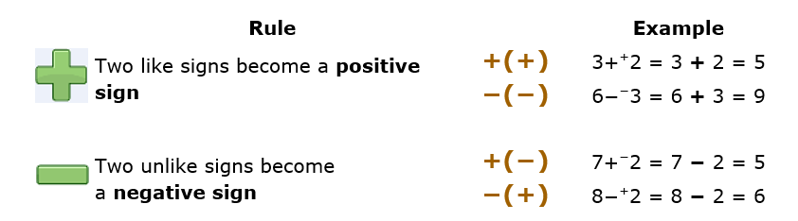
24
7
30
Adding and Subtracting Review
Date:
EQ – What are the rules for adding and subtracting integers?
Keep all digits aligned in place values including decimal point
Question
Rules for adding and subtracting integers

Slide 4
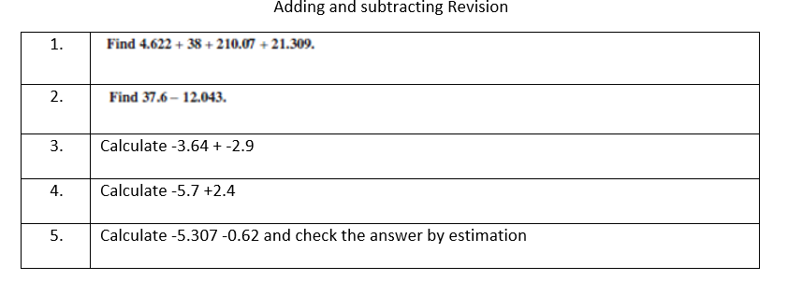
Practice
Notes:
Guide students through the question.
Option 2: Dot plots handout (Scaffolded for kids who may need extra help)

